Slide 1

Chapter 3
REGULAR LANGUAGES AND REGULAR GRAMMARS

Slide 2

Learning Objectives At the conclusion of the chapter, the student will be able to:
Identify the language associated with a regular expression
Find a regular expression to describe a given language
Construct a nondeterministic finite automaton to accept the language denoted by a regular expression
Use generalized transition graphs to construct a regular expression that denotes the language accepted by a given finite automaton
Identify whether a particular grammar is regular
Construct regular grammars for simple languages
Construct a nfa that accepts the language generated by a regular grammar
Construct a regular grammar that generates the language accepted by a finite automaton

Slide 3
Regular Expressions
Regular Expressions provide a concise way to describe some languages
Regular Expressions are defined recursively. For any alphabet:
the empty set, the empty string, or any symbol from the alphabet are primitive regular expressions
the union (+), concatenation (⋅), and star closure (*) of regular expressions is also a regular expression
any string resulting from a finite number of these operations on primitive regular expressions is also a regular expression

Slide 4
Languages Associated with Regular Expressions
A regular expression r denotes a language L(r)
Assuming that r₁ and r₂ are regular expressions:
The regular expression ∅ denotes the empty set
The regular expression λ denotes the set { λ }
For any a in the alphabet, the regular expression a denotes the set { a }
The regular expression r₁ + r₂ denotes L(r₁) ∪ L(r₂)
The regular expression r₁ ⋅ r₂ denotes L(r₁) L(r₂)
The regular expression (r₁) denotes L(r₁)
The regular expression r₁* denotes (L(r₁))*

Slide 5
Determining the Language Denoted by a Regular Expression
By combining regular expressions using the given rules, arbitrarily complex expressions can be constructed
The concatenation symbol (⋅) is usually omitted
In applying operations, we observe the following precedence rules:
star closure precedes concatenation
concatenation precedes union
Parentheses are used to override the normal precedence of operators

Slide 6
Sample Regular Expressions and Associated Languages
Regular Expression | Language
(ab)* | { (ab)^{n}, n ≥ 0 }
a + b | { a, b }
(a + b)* | { a, b }* (in other words, any string formed with a and b)
a(bb)* | { a, abb, abbbb, abbbbbb, … }
a*(a + b) | { a, aa, aaa, …, b, ab, aab, … } (Example 3.2)
(aa)*(bb)*b | { b, aab, aaaab, …, bbb, aabbb, … } (Example 3.4)
(0 + 1)*00(0 + 1)* | Binary strings containing at least one pair of consecutive zeros
Two regular expressions are equivalent if they denote the same language. Consider, for example, (a + b)* and (a*b*)*

Slide 7
Regular Expressions and Regular Languages
Theorem 3.1: For any regular expression r, there is a nondeterministic finite automaton that accepts the language denoted by r
Since nondeterministic and deterministic accepters are equivalent, regular expressions are associated precisely with regular languages
A constructive proof of theorem 3.1 provides a systematic procedure for constructing a nfa that accepts the language denoted by any regular expression

Slide 8
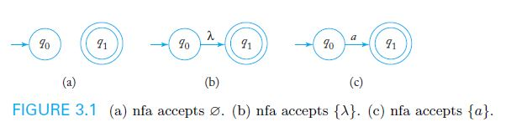
Construction of a nondeterministic fa to accept a language L(r)
We can construct simple automata that accept the languages associated with the empty set, the empty string, and any individual symbol.

Slide 9
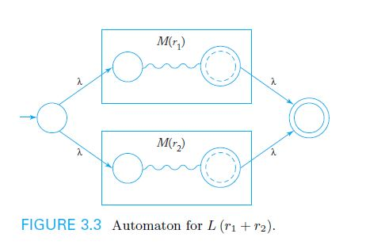
Construction of a nondeterministic fa to accept a language L(r) (cont.)
Given schematic representations for automata designed to accept L(r₁) and (r₂), an automaton to accept L(r₁ + r₂) can be constructed as shown in Figure 3.3

Slide 10
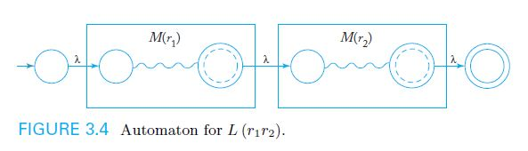
Construction of a nondeterministic fa to accept a language L(r) (cont.)
Given schematic representations for automata designed to accept L(r₁) and (r₂), an automaton to accept L(r₁r₂) can be constructed as shown in Figure 3.4

Slide 11
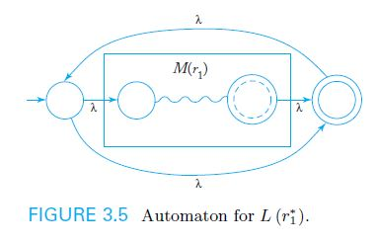
Construction of a nondeterministic fa to accept a language L(r) (cont.)
Given a schematic representation for an automaton designed to accept L(r₁), an automaton to accept L(r₁*) can be constructed as shown in Figure 3.5

Slide 12
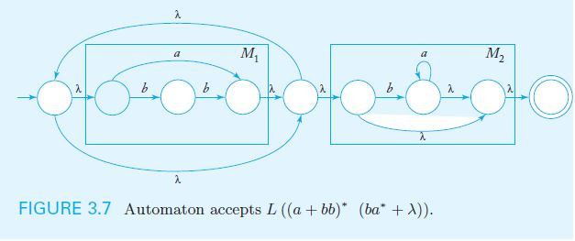
Example: Construction of a nfa to accept a language L(r)
Given the regular expression r = (a + bb)* (ba* + λ), a nondeterministic fa to accept L(r) can be constructed systematically as shown in Figure 3.7

Slide 13
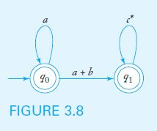
Regular Expressions for Regular Languages
Theorem 3.2: For every regular language, it is possible to construct a corresponding r.e.
The process can be illustrated with a generalized transition graph (GTG)
A GTG for L(a* + a*(a + b)c*) is shown below

Slide 14
Regular Grammars
In a right-linear grammar, at most one variable symbol appears on the right side of any production. If it occurs, it is the rightmost symbol.
In a left-linear grammar, at most one variable symbol appears on the right side of any production. If it occurs, it is the leftmost symbol.
A regular grammar is either right-linear or left-linear.
Example 3.13 presents a regular (right-linear) grammar:
V = { S }, T = { a, b }, and productions S → abS | a

Slide 15
Right-Linear Grammars Generate Regular Languages
Per theorem 3.3, it is always possible to construct a nfa to accept the language generated by a regular grammar G:
Label the nfa start state with S and a final state V_{f}
For every variable symbol V_{i} in G, create a nfa state and label it V_{i}
For each production of the form A → aB , label a transition from state A to B with symbol a
For each production of the form A → a, label a transition from state A to V_{f} with symbol a (may have to add intermediate states for productions with more than one terminal on RHS)

Slide 16
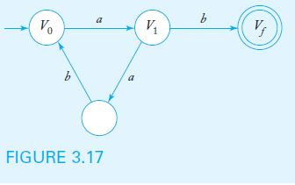
Example: Construction of a nfa to accept a language L(G)
Given the regular grammar G with productions
V₀ → aV₁
V₁ → abV₀ | b
a nondeterministic fa to accept L(G) can be constructed systematically as shown in Figure 3.17

Slide 17
Right-Linear Grammars for Regular Languages
Per theorem 3.4, it is always possible to construct a regular grammar G to generate the language accepted by a dfa M:
Each state in the dfa corresponds to a variable symbol in G
For each dfa transition from state A to state B labeled with symbol a, there is a production of the form A → aB in G
For each final state F_{i} in the dfa, there is a corresponding production F_{i} → λ in G

Slide 18
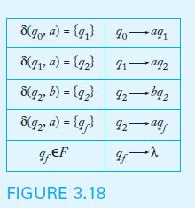
Example: Construction of a regular grammar G to generate a language L(M)
Given the language L(aab*a), Figure 3.18 shows the transition function for a dfa that accepts the language and the productions for the corresponding regular grammar.

Slide 19
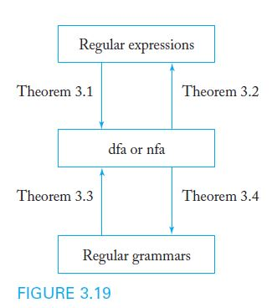
Equivalence of Regular Languages and Regular Grammars

